Slide 1
Superintendent’s Proposed Budget
Fiscal Year 2022-23
March 24, 2022

Slide 2
Enrollment Trends and Projections
In the aggregate, current enrollment in North Carolina traditional school districts remains approximately four percent below 2019-20 (pre-Covid) levels.
DPS enrollment follows this statewide trend and is projected to remain approximately four percent below 2019-20 levels in FY 2022-23.
Enrollment projections are tempered by the lack of anticipated rebound in 2020-21.
If opt-out decisions by families who previously attended or who were planning to enroll in DPS prior to the pandemic reverse strongly in 2022-23, actual enrollment could exceed projections.
There is no expectation, however, of a state hold-harmless provision for enrollment in 2022-23; school districts must take this into account for the 2022-23 budget and allotments.
Notes:
Charter school growth has slowed in Durham as well during the pandemic, and is projected to grow slightly in 2022-23, driven primarily by Excelsior and Discovery Charter.

Slide 3
Enrollment Projections & Budget Impact
DPS will have some local savings from school allotment adjustments based on the enrollment projections but will also lose significant state funding.
Local funds will need to support certain positions and fixed costs at each school that do not decrease unless enrollment hits certain thresholds.
Additionally, DPS must also use local funds to absorb significant adverse impact from recent legislative changes, including:
HB-90 class size requirements: DPS must add additional teachers (without additional state funds) if Kindergarten, 1st, or 2nd/3rd grade class sizes exceed 21, 19, or 20 students.
An annual reduction of approximately $860K in state at-risk funds due to a decline in overall Durham County poverty levels despite no significant decline in poverty levels among DPS families.
For these reasons, the DPS local budget request does not include a reduction in local funding based on the short-term, pandemic-induced enrollment decline that is likely to continue in 2022-23.
Notes:
Charter school growth has slowed in Durham as well during the pandemic, and is projected to grow slightly in 2022-23, driven primarily by Excelsior and Discovery Charter.

Slide 4
Budget Request Highlights
The largest line item is a $4M request to increase the starting teacher salary supplement from $5,675 to $6,500, with commensurate increases across the board.
Durham was one of five counties excluded from $100M in state ‘supplemental’ funding for higher teacher pay ranging from $400 to $4,000 per teacher.
The proposed increase will put our teacher salary supplement on par with Wake and Chapel Hill, the two highest paying districts in the state.
The local budget also includes:
Required funding to cover an anticipated 2.5% salary increase for certified and classified employees and rapidly escalating retirement and heath insurance cost increases.
Operating costs for Lyons Farm Elementary, including custodial and front office personnel and estimated utility expenses.
A request for seven additional IT technicians to support digital learning in our schools as a one-to-one district.
Emergency Federal COVID-19 funds will continue to support expanded summer learning, instructional support personnel, staff retention, building improvements and other COVID-19 mitigation efforts, digital learning, and school-level supports.
Notes:
Charter school growth has slowed in Durham as well during the pandemic, and is projected to grow slightly in 2022-23, driven primarily by Excelsior and Discovery Charter.

Slide 5
FY 2022-23 Local Funding Request
Local Budget Requirements for DPS and Charter Schools - FY 2022-23
 | Line-Item Description | Cost
DPS Anticipated State Salary/Benefit and Fixed Cost Increases | Certified Salary Increase (2.5% estimate for FY 2022-23) | $875,000
 | Classified Salary Increase (2.5% estimate for FY 2022-23) | $850,000
 | Bus driver pay increases implemented in October 2021 due to national shortage - new range is $17.43-$24.60/hr. | $1,050,000
 | Retirement (22.89% to 24.5%) | $750,000
 | Health Insurance ($7,019 to $7,500) | $975,000
 | Utilities, Property/Liability Insurance, Workers Compensation, and Other Contract Increases | $800,000
 | Subtotal | $5,300,000
Teacher Salary Supplement Increase | Increase starting supplement from $5,675 to $6,500 with commensurate increases for all years of experience | $4,000,000
 | Subtotal | $4,000,000
Lyons Farm Elementary | 3.5 FTE custodial positions for the 85,000 sq. ft. facility | $180,000
 | 3 FTE front office staff (treasurer, data manager, and administrative assistant) | $195,000
 | Assistant Principal | $110,000
 | Subtotal | $485,000
Information Technology | Seven workstation technicians to phase-in local support of 1:1 initiative | $515,000
 | Subtotal | $515,000
Total DPS Annual Operating Requirements |  | $10,300,000
Charter School Requirements | Additional charter funds associated with requested DPS operating budget increase (based on 19.2% of total Durham County K-12 enrollment) | $2,575,000
 | Charter School New Money Requirements | $2,575,000
Grand Total |  | $12,875,000
Notes:
DPS will continue to use non-recurring ESSER funds in FY 2022-23 for additional school support staff such as mental health counselors and school counselors.
Additional local support be required to maintain these positions in subsequent fiscal years if the state does not increase instructional support allotments.

Slide 6
FY 2022-23 Local Funding Request
Summary of Requested Durham County Appropriations
Appropriation Type | Description | FY 2021-22 Approved | FY 2022-23 DPS Proposed Budget | DPS Proposed Increase
Operating Funds | DPS Operations | $129,302,638 | $139,602,638 | $10,300,000
 | Charter Schools | $30,395,849 | $32,970,849 | $2,575,000
 | Total: DPS & Charters | $159,698,487 | $172,573,487 | $12,875,000
Pre-K Grant Funds | The Whitted School | $1,500,000 | $1,500,000 | $0
 | District-Wide Pre-K Programs | $508,140 | $508,140 | $0
 | Total Pre-K Grant Funds | $2,008,140 | $2,008,140 | $0
Capital Funds | Building Improvements | $6,000,000 | $6,000,000 | $0
Total |  | $167,706,627 | $180,581,627 | $12,875,000
Notes:
DPS will continue to use non-recurring ESSER funds in FY 2022-23 for additional school support staff such as mental health counselors and school counselors.
Additional local support be required to maintain these positions in subsequent fiscal years if the state does not increase instructional support allotments.

Slide 7
Teacher Salary Supplement
The FY 2022-23 proposal increases the starting DPS teacher supplement from $5,675 to $6,500.
With the schedule increase and year of experience step, most teachers will receive an additional $1,135 annually in FY 2023-23.
The FY 2022-23 proposal is on average $2,262 higher than the 2016-17 DPS schedule; DPS teachers employed since 2016-17 will be paid $3,138 more on average than their 2016-17 supplement.

Slide 8
Budget Summary by Fund Source
Fund Source | Revenue | % of Total | Positions
State | $234,143,178 | 34.5% | 3,179
Local | $151,572,926 | 22.3% | 1,226
Federal (recurring) | $38,545,050 | 5.7% | 313
Federal - COVID Relief | $112,223,022 | 16.5% | 212
Capital Fund | $109,358,534 | 16.1% | 0
Child Nutrition | $19,039,716 | 2.8% | 205
Grants & Receipts | $13,490,356 | 2.0% | 137
Total* | $678,372,782 | 100.0% | 5,272
*Excludes $33.0M in local revenues passed through to charter schools serving an estimated 7,512 Durham students in FY 2022-23.

Slide 9
Budget Summary by Purpose
Purpose | Current Budget | % of Total | Positions
School-Based Instructional Services | $407,069,181 | 60.0% | 4,072
Capital Investments | $133,634,046 | 19.7% | 0
Operational Support | $64,593,569 | 9.5% | 672
Administrative & Instructional Support | $25,094,197 | 3.7% | 160
Ancillary Services | $27,215,830 | 4.0% | 288
Information Technology | $15,356,751 | 2.3% | 80
Indirect Cost and Transfers | $5,409,209 | 0.8% | 0
Total* | $678,372,782 | 100.0% | 5,272
*Excludes $33.0M in local revenues passed through to charter schools serving an estimated 7,512 Durham students in FY 2022-23.

Slide 10
Budget Summary by Object
Category | Budget | % of Total | % of Non-Capital Budget
Salaries | $320,871,237 | 47.3% | 59.1%
Benefits | $128,118,752 | 18.9% | 23.6%
Purchased Services | $43,548,758 | 6.4% | 8.0%
Supplies and Materials | $49,672,023 | 7.3% | 9.2%
Capital Investments | $135,697,421 | 20.0%
Transfers | $464,592 | 0.1% | 0.1%
Total | $678,372,782 | 100.0% | 100.0%
*Excludes $33.0M in local revenues passed through to charter schools serving an estimated 7,512 Durham students in FY 2022-23.

Slide 11
DPS Personnel Summary
Durham Public Schools is the third largest employer in the county with 5,272 full-time equivalent employees
Teachers – 2,581 (49.0% of all DPS employees) - Includes regular classroom instruction, art/music/PE, career and technical education, and specialized instruction for students with disabilities, English language learners, and academically gifted students. Instructional Support Personnel – 1,217 (23.1% of all DPS employees) - Includes teacher assistants, math and literacy coaches, instructional facilitators, librarians, guidance counselors, social workers, nurses, psychologists, school-based specialists, speech pathologists, physical and occupational therapists, psychologists, audiologists, bus monitors, interpreters, translators, and teacher mentors. Operational Support Personnel – 802 (15.2% of all DPS employees) - Includes bus drivers, custodians, cafeteria workers, and skilled trades.
Technical & Administrative Support Personnel – 321 (6.1% of all DPS employees) - Primarily school-based administrative support staff including treasurers, data managers, IT technicians, and secretaries, along with centralized administrative staff in finance, human resources, operations, and academic support services.
School Leadership – 167 (3.2% of all DPS employees) - Includes principals, assistant principals, and assistant principal interns.
Centralized Administrators – 103 (2.0% of all DPS employees) - Includes senior DPS leadership and other centralized directors, supervisors, and administrative specialists across academic, administrative, and operational support services.
Before & After School Care Program – 81 (1.5% of all DPS employees) - includes group leaders, site managers, and administrative support

Slide 12
Budget Calendar
March:
Present Superintendent’s Proposed Budget at BOE work session or regular meeting.
Public hearing on the FY 2022-23 Superintendent’s Proposed Budget.
Provide FY 2022-23 school planning allotments to principals.
April:
Public hearing on the FY 2022-23 Superintendent’s Proposed Budget.
BOE adopts the FY 2022-23 Superintendent’s Proposed Budget with revisions if necessary.
Allotment meetings with school principals.
May/June:
Durham County Manager’s Proposed Budget Presentation: May 9th
Durham County Budget Work Sessions: May 17th – June 8th
Durham County Budget Public Hearing: May 23rd
Durham County Budget Adoption: June 13^{th.}
Interim Budget Resolution presented to Board of Education for FY 2022-23.

Slide 13
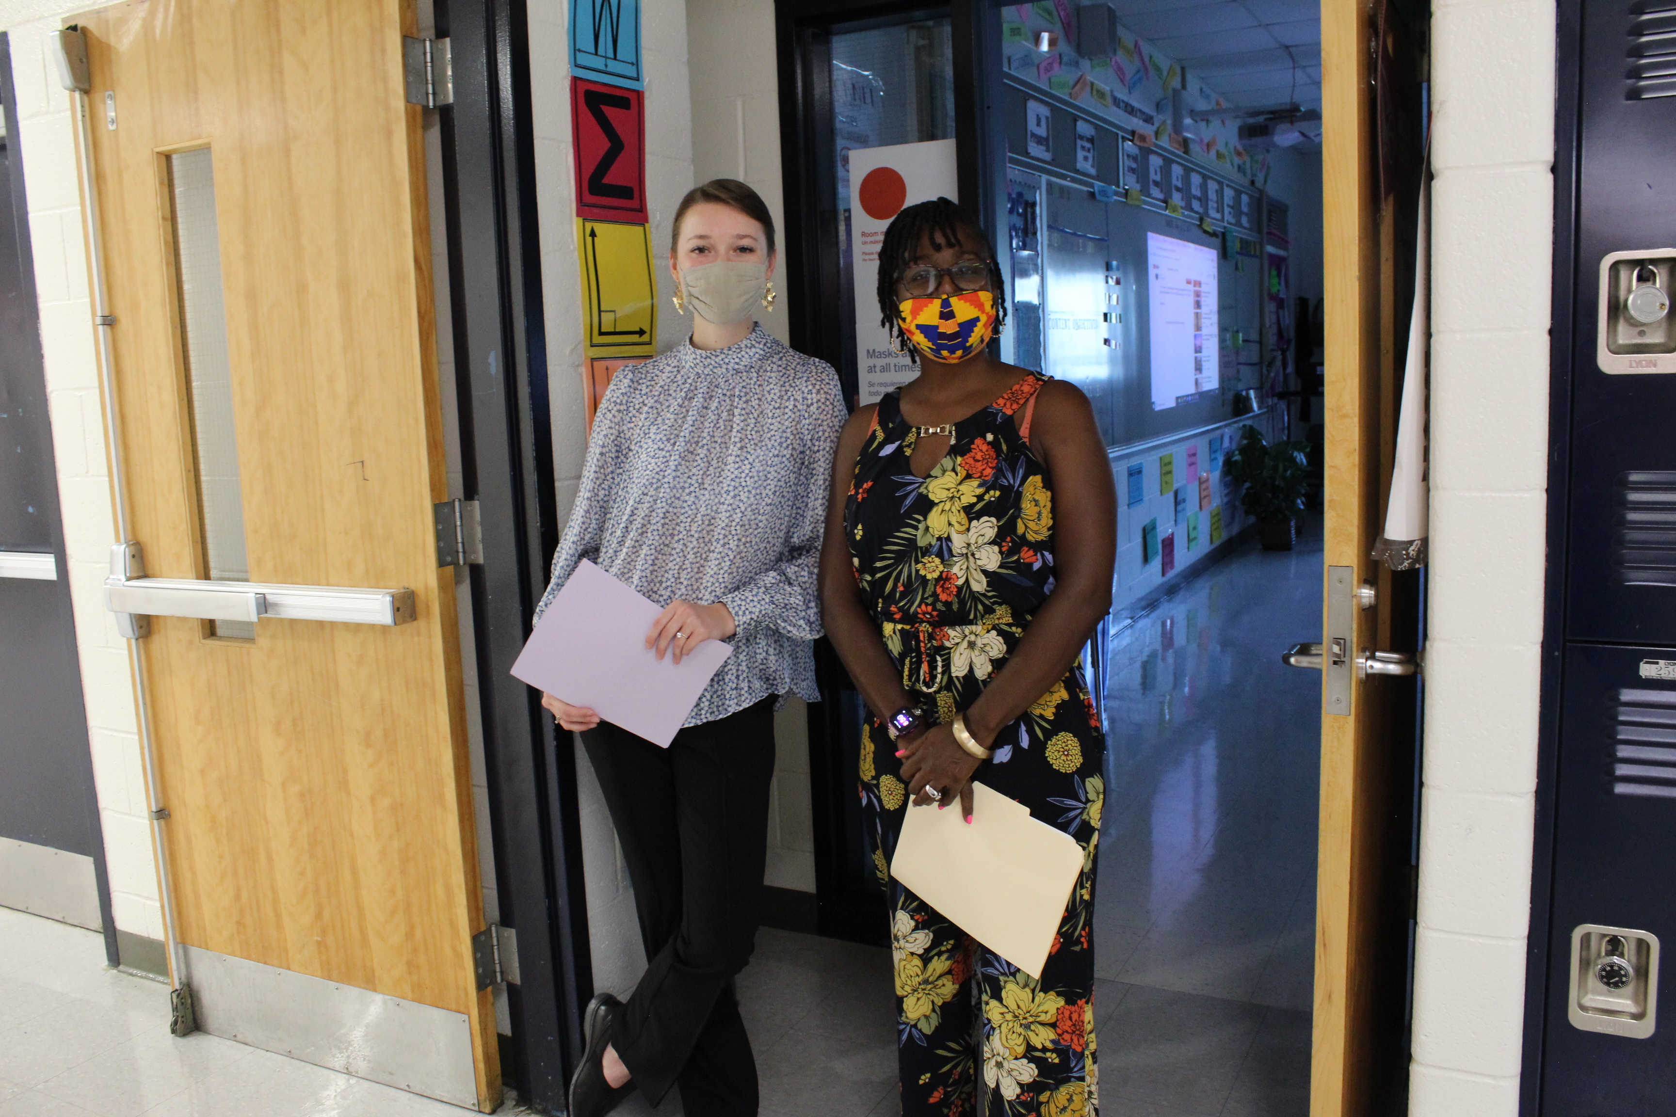
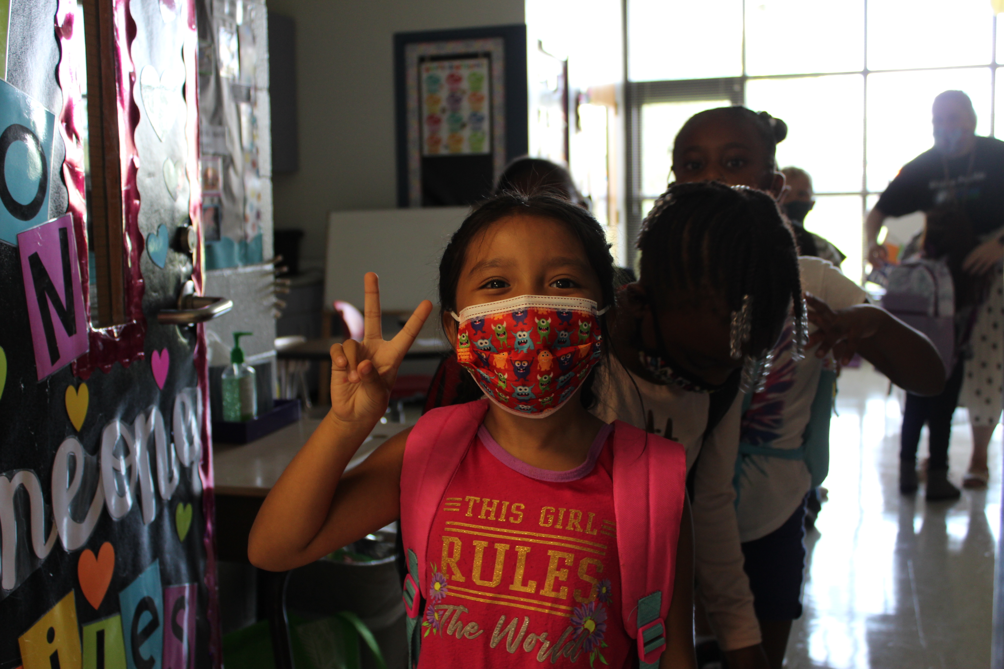
Discussion & Questions

Slide 14
Federal COVID-19 Relief Funds Update

Slide 15
COVID-Related Appropriations
Three major acts of congress provide K-12 public school districts with Coronavirus Response and Recovery funding:
Coronavirus Aid, Relief, and Economic Security (CARES) – enacted in May 2020.
Coronavirus Response and Relief Supplemental Appropriation (CRRSA) – enacted in December 2020.
American Recovery Plan (ARP) – enacted in March 2021.
Each act includes an Elementary and Secondary Schools Education Relief (ESSER) subsection that provides funding for K-12 education. The allocations are denoted as ESSER – I for CARES, ESSER II for CRRSA, and ESSER – III for ARP.
The primary ESSER allocation for each act is for K-12 Emergency Relief, with provide school districts with the greatest flexibility on the use of funds.
CARES Act – ESSER I – K-12 Emergency Relief – PRC 163 – $11.9M – expires Sep. 30, 2022
CRRSA Act – ESSER II – K-12 Emergency Relief – PRC 171 – $46.5M – expires Sep. 30, 2023
APR Act – ESSER III – K-12 Emergency Relief – PRC 181 – $104.3M – expires Sep. 30, 2024

Slide 16
CARES Act Appropriations
 | Summary of CARES Act Appropriations and Expenditures
Federal Legislation | Program Description | Total Allotment | FY 2020-21 Expenditures | FY 2021-22 YTD Expenditures and Encumbrances | Balance Remaining (as of 03/21/2022) | Percent Remaining | Fund Expiration Date
CARES | ESSER I - K-12 Emergency Relief | $11,927,439 | $8,199,368 | $3,132,114 | $595,957 | 5% | 9/30/2022
 | ESSER I - Digital Curricula | $231,621 | $112,454 | $116,366 | $2,801 | 1%
 | ESSER I - Learning Management System | $23,188 | $0 | $23,188 | $0 | 0%
 | ESSER I - Exceptional Children Grants | $208,277 | $0 | $0 | $208,277 | 100%
 | GEER I - Specialized Instructional Support | $766,236 | $86,688 | $330,354 | $349,194 | 46%
 | GEER I - Supplemental Instructional Services | $520,290 | $11,065 | $209,807 | $299,418 | 58%
 | Total | $13,677,051 | $8,409,576 | $3,811,829 | $1,455,647 | 11%
CARES Act funds were allotted to districts in the Spring of 2020 and enabled DPS to quickly pivot to a 1:1 district (device to student ratio) to support remote learning in the height of the pandemic.
DPS expended more than 60 percent of CARES Act funds in FY 2020-21, primarily on student devices and internet connectivity.
Remaining funds budgeted in the 2021-22 academic year are supporting student device refresh, educational software for digital learning, and specialized instructional support services.
Notes:
The CARES act also includes smaller, more targeted allotments in specific areas:
Program code 165 – Digital Curricula – $232K – utilized for Nearpod software.
Program code 166 – Learning Management System – $23K – utilized for Canvas subscriptions.
Program code 167 – Exceptional Children grants – $208K – budgeted for enhanced summer programming.
Program code 169 – Specialized Instructional Support – $680K – is allotted to support temporary employment or contracted services for school counselors, school nurses, school psychologists, and school socials workers.
Program code 170 – Supplemental Instructional Services – $509K – is allotted for support the academic needs of at-risk students.

Slide 17
CRRSA and ARP Appropriations
Summary of Federal CRRSA and ARP Funds Allocated to Durham Public Schools
Federal Legislation | Program Description | Total Allotment | FY 2020-21 Expenditures | FY 2021-22 YTD Expenditures & Encumbrances | Remaining Balance (as of 03/21/22) | Percent Remaining | Fund Expiration Date
CRRSA | ESSER II - K-12 Emergency Relief | $46,633,813 | $2,898,666 | $16,531,138 | $27,204,009 | 58% | 9/30/2023
 | ESSER II - Supplemental Contracted Instructional Support Funding | $215,112 | $0 | $0.00 | $215,112 | 100%
 | ESSER II - School Nutrition Covid Support | $234,251 | $0 | $183,194 | $51,057 | 22%
 | ESSER II - Learning Loss Funding | $874,741 | $0 | $0.00 | $874,741 | 100%
 | ESSER II - Summer Career Accelerator | $567,109 | $0 | $0.00 | $567,109 | 100%
 | ESSER II - Competency-Based Assessment | $190,441 | $0 | $0.00 | $190,441 | 100%
ARP | ESSER III - K-12 Emergency Relief | $104,282,855 | $0 | $8,723,348 | $95,559,507 | 92% | 9/30/2024
 | ESSER III - Homless Grant - I | $150,000 | $0 | $0.00 | $150,000 | 100%
 | ESSER III - Homeless Grant - II | $400,524 | $0 | $0.00 | $400,524 | 100%
 | ESSER III - IDEA Grants to States | $1,892,278 | $0 | $0.00 | $1,892,278 | 100%
 | ESSER III - IDEA Preschool Grants | $122,044 | $0 | $0.00 | $122,044 | 100%
 | Total | $155,563,168 | $2,898,666 | $25,856,901 | $126,807,601 | 82%
The K-12 Emergency Relief allotments in CRRSA and ARP total $150.9M out of the $155.6M grand total and allow for the greatest flexibility in the use of funds.
The remaining $4.6M in CRRSA and ARP grants are allocated more narrowly to support specific programs, with limited district flexibility.
Additional information may be found at the North Carolina Department of Public Instruction COVID funds website.

Slide 18
CRRSA and ARA Act Appropriations
$53.7 M (35.6 percent) of ESSER II/III K-12 Emergency Relief funds are budgeted in Operational Services; major allocations include:
$34.34M for Facility Repairs and Improvements to improve air quality and minimize virus transmission (including permanent outdoor learning spaces on each campus).
$8.93M for Education Technology to support 1:1 implementation including hardware, software, IT technician staffing, cyber security upgrades, and network upgrades.
$6.23M for enhanced school cleaning and disinfecting
$2.02M for transportation to support extended day and summer programs
$1.14M for child nutrition to support needs stemming from Covid-19.

Slide 19
CRRSA and ARA Act Appropriations
$53.3 M (35.3 percent) of ESSER II/III K-12 Emergency Relief funds are budgeted in Academic Services; major allocations include:
$25.1M for summer learning in 2021, 2022, and 2023
$17.1M for 100 temporary 2-year school-based positions including 55 learning acceleration positions, 22 EC and ESL positions, 11 mental health counselors, 4 professional school counselors, and 8 student success coaches (for middle and high schools).
$7.1 for 40 districtwide and itinerant school-support positions including 8 digital teaching and learning coaches, 10 media tech assistants, 10 behavioral support positions, 4 literacy integration specialist, 4 EC specialists, 3 MLRC positions, and an outdoor learning specialist.
Notes:
The remaining $2.5M is budgeted for high-quality school curriculum beyond what can be support with existing state and local funds, as well as contracted services for SEL and other student supports

Slide 20
CRRSA and ARA Act Appropriations
Staff recruitment and retention initiatives:
In FY 2021-22, DPS offered new hire recruitment bonuses in certain hard-to-staff areas ranging from $1,500 to $8,000 to be paid out over three years. The total estimated cost is approximately $3.5M.
DPS issued a $1,538.50 pre-tax retention bonuses in November 2021 and will issue two additional $1,500 retention bonuses in March 2022 and October 2022. The total estimated cost is $22.5M.
DPS also used $1.1M in ESSER funds to ensure that locally and federally funded teachers received the state-mandated teacher bonuses in the 2021 Appropriations Act.
$900K is budgeted for other HR initiatives, such at teacher assistant to teacher tuition reimbursement.
School-Level Strategies:
$12.8M is currently earmarked for funds that will be distributed to schools to support learning acceleration.
Administrative and Ancillary Services:
$1.6M for the COVID-19 team: 10 contract tracers, one communication specialist, and one team manager.
$600K in contingency funds to support for before and after school programs.
Notes:
HR recruitment support includes:
including Latinx recruitment, testing reimbursement, TA to teacher program support, EC recruitment, and transitional support efforts.

Slide 21
Employee Benefit Cost Trends
In the past five years, employee retirement costs increased at an average rate of six percent per year; health insurance costs increased at five percent per year.
Employee benefit costs continue to put added strain on the local budget each year, especially as Federal programs do not keep up with this inflationary pressure.

