Slide 1
Proposed Budget and Superintendent’s Message
FY 2016-17
Presented to the Board of Education April 14, 2016

Slide 2
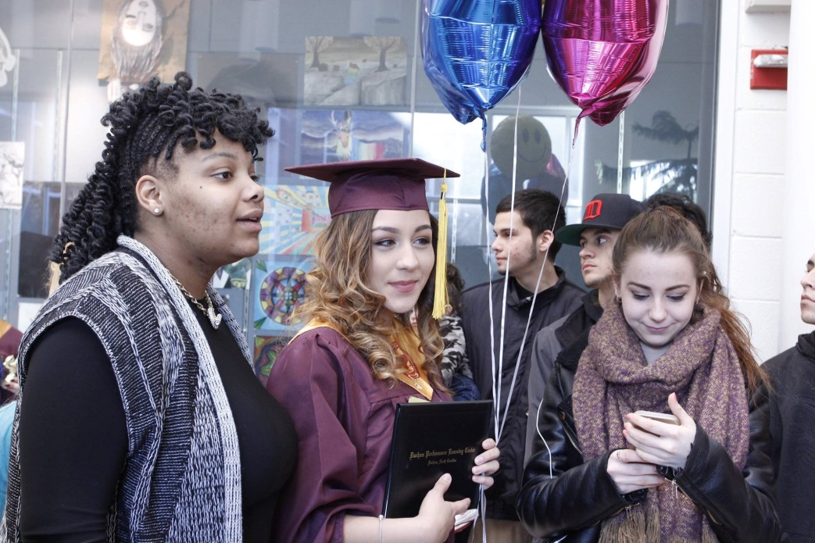
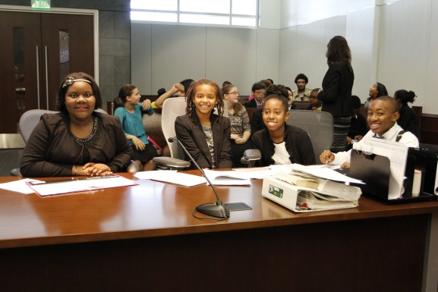
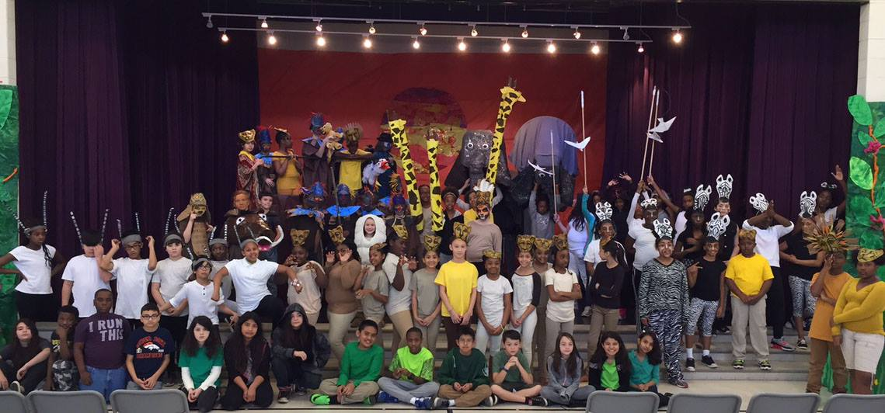
Superintendent’s Message

Slide 3
Two Challenges
We must accelerate student achievement
Incremental progress not enough
Urgent need to close achievement gaps
We must place DPS on a sustainable financial footing
Reduce reliance on fund balance
Request county funding for enrollment growth/inflation
Reduce central services expenditures

Slide 4
Moving forward
Make changes that help us support our students for the long run
Reorganize central services for highest return on student achievement
Better position DPS to vet and propose future expansion items that will narrow achievement gaps and accelerate student progress

Slide 5
Budget Guiding Principles
Impact on students and schools Provide funding that directly impacts our students and teachers Promote social justice and equity Develop certified salary schedule that moves our teachers to the national average, competes with neighboring counties and provides annual compensation increases Implement classified salary increases and develop a salary schedule that allows for annual step increases and strives to provide a cost of living increase | Review current staffing formulas across the district and continue our investment in classroom teachers and staff Review current non-salary allotments to individual schools Stewardship Develop a funding formula between the Board and County Collect feedback from stakeholders and community on budget priorities Monitor DPS and Charter enrollments | Provide accurate projections of student membership Reduce the dependency on committed fund balance to cover salary and benefits Review all contracts within the district for appropriateness and potential savings Review all operational expenditures to maximize efficiency and potential savings

Slide 6
Proposed Budget FY 2016-17 Highlights
$403.1 Million Dollar Proposed Budget
$138.4 Million Dollar Local Budget
Funds 4,612 Positions
822 Local Paid Positions
360 Local Paid Teachers
Matches state projected raises
Funds classified increases implemented 1/1/2016

Slide 7
Proposed Budget FY 2016-17 Increases - Local
Proposed Teacher and Certified Personnel Raises at 5%
Proposed Classified Raises at 3%
Increased Supplement Cost for Certified Raises
Funds Classified Salary Increase Granted 1/1/16
Additional Elementary Teaching Positions
Projected Growth
Fixed Cost Increases
Benefits
Contracts
Utilities

Slide 8
Proposed Budget FY 2016-17 Reductions - Local
Central Office Reductions 91.5 Positions, $9.3M
Teacher Assistant Reduction $1.9M
One time funding for summer reading program and technology upgrades $800K

Slide 9
Potential Budget Risk
Senate Bill 744 – growth no longer funded in state continuation budget
Will the state fund statewide student growth?
Will other state reductions be required to fund the growth?
2nd year of Biennial budget funds growth…..
Utility rate increases?
State legislated compensation increases beyond estimates
State employer benefit rate increases beyond estimates
2016-17 Drivers Ed Training funded through Fines & Forfeitures → Changes? Beyond 2016-17?
Teaching Assistant funding changes?
Charter School funding changes → Unpredictable impact
House Bill 539, which would require traditional public schools to share more of their funds with charter schools. The bill, which was rewritten and passed by the N.C. Senate in September, died in a House committee but is eligible to be brought back when the General Assembly returns April 25 Read more here: http://www.newsobserver.com/news/local/education/wake-ed-blog/article66947082.html#storylink=cpy
Read to Achieve Camp costs beyond funding provided?

Slide 10
Proposed Budget FY 2016-17 Summary

Slide 11
Proposed Budget FY 2016-17 Summary

Slide 12
FY 2016-17 Proposed Budget

Slide 13
FY 2016-17 Proposed Budget

Slide 14
Revenue
Funding Sources (Estimated) | Amount | % of Total
Local - County | $117,812,345 | 29%
¼ Cent Sales Tax Revenue for operations | 7,785,222 | 2%
DPS Local Revenues - $5.4M (E-Rate, Medicaid, Fines and Forfeitures, and Indirect Cost) | 7,369,338 | 2%
DPS Local Revenues - Fund Balance | 5,479,769 | 1%
Capital Outlay (Includes $1M State Lottery) | 5,969,886 | 2%
School Construction Bonds | 10,354,898 | 3%
State Revenue | 194,690,676 | 48%
Federal Revenue | 29,144,707 | 7%
Child Nutrition | 17,139,923 | 4%
Community Ed/ Grants (includes $466,489 of ¼ cent sales tax for Pre-K) | 7,381,435 | 2%
Total- All Funding Sources | $403,128,199 | 100%

Slide 15
Average Daily Membership(ADM)

Slide 16
Durham County Student Growth

Slide 17
Durham Public School Enrollment
Projected Enrollment 15-16 33,979
20th Day Enrollment 15-16 33,501
Projected Enrollment 16-17 33,454
Decrease of 525 students from previous year projected enrollment
Decrease of 47 students from 20th day enrollment

Slide 18
Charter School Enrollment
Durham Based Charter Schools (13)
Enrollment 15-16 5,382
Out of District Charter Schools (24)
Enrollment 15-16 453
Virtual Charter Schools (2)
Enrollment 15-16 112
Total Number of Charter School (39)
Enrollment 15-16 5,947

Slide 19
Charter Schools
FY 2016-17 Projected Payment to Charters $21,025,425
Charter Schools enrollment projected to be 16.5% of overall enrollment
Projected Charter School increase for FY 2016-17 is 662 students

Slide 20
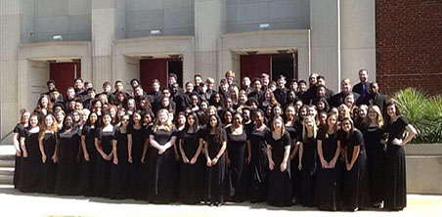
Fund Balance

Slide 21
Fund Balance

Slide 22
Proposed Budget FY 2016-17

Slide 23
New Money Request
Growth – Charter Schools $2,000,000
Fixed Cost $ 750,000
Benefits
Utilities
Contracts
Total New Money Request $2,750,000*
*Charter School Funding Percentage of New Money $2,750,000 X 16.5% = $453,750
Total Charter School Funding $2,453,750
New Money Durham Public Schools $ 296,250

Slide 24
Proposed Budget FY 2016-17

Slide 25
Proposed Budget FY 2016-17 Timeline
Date | Time | Event
April 14, 2016 | 4:00pm | Presentation of Proposed Budget and Superintendent’s Message FY 2016-17 to Board of Education (BOE)
April 18, 2016 | 6:00pm | Budget Public Hearing
April 28, 2016 | 6:30pm | Regular Board of Education Meeting - Adopt FY 2016-17 Budget
April 29, 2016 |  | Adopted Board of Education FY 2016-17 Budget submitted to the County
May 23, 2016 | 7:00pm | County Manager presents Durham County Proposed FY 2016-17 Budget
June 27, 2016 | 7:00pm | County Commissioners approve FY 2016-17 Budget

Slide 26
Next Steps:
County Commissioner approval of funding level
State Budget(Governor, House, Senate, Final Budget)
Monitor ADM for DPS students and charter schools
Continued review of expenditures and programs
Provide schools updates on allotments
Steps to reduce the dependency on committed fund balance

Slide 27
Special Thank You To!!!!!!!!!!!!!!!
Budget Department
Senior Staff
Principals
Board of Education
Budget Advisory Committee

Slide 28
Questions:

Slide 29
Proposed Budget and Superintendent’s Message
FY 2016-17
Presented to the Board of Education April 14, 2016

